Slide 1
DESIGN AND SIMULATION OF
HALF ADDER AND FULL ADDER
USING LOGISIM

Slide 2
OBJECTIVES
Understand binary addition.
Design a Half Adder using XOR and AND gates.
Design a Full Adder using XOR, AND and OR gates.
Simulate both circuits in Logisim.
Verify the results using truth tables.
Conclusion.

Slide 3
INTRODUCTION
BINARY ADDITION
• An Adder is a combinational logic circuit used to perform binary addition.
• A Half Adder adds two 1-bit binary inputs.
• A Full Adder adds three 1-bit inputs, including Carry Input (Cin).
• The main outputs are Sum and Carry.
0 + 0 = 0 0 + 1 = 1 1 + 0 = 1 1 + 1 = 10

Slide 4
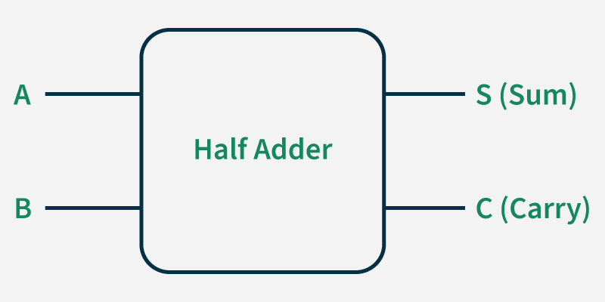
HALF ADDER – CONCEPT AND BOOLEAN EXPRESSIONS
• Inputs: A and B
• Outputs: Sum (S) and Carry (C)
• Sum equation: S = A ⊕ B
• Carry equation: C = A · B

Slide 5
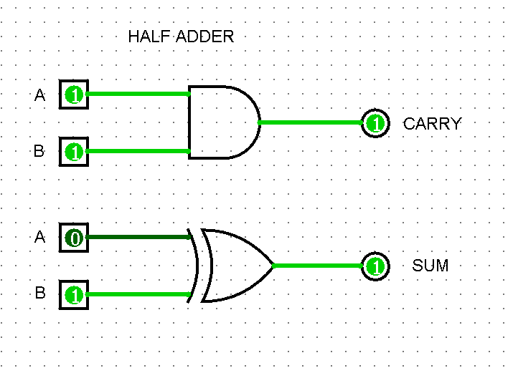
HALF ADDER – LOGISIM SIMULATION EVIDENCE
Suggested test: A = 1, B = 1 → Sum = 0, Carry = 1

Slide 6
HALF ADDER – TRUTH TABLE
A | B | Sum (S) | Carry (C)
0 | 0 | 0 | 0
0 | 1 | 1 | 0
1 | 0 | 1 | 0
1 | 1 | 0 | 1

Slide 7
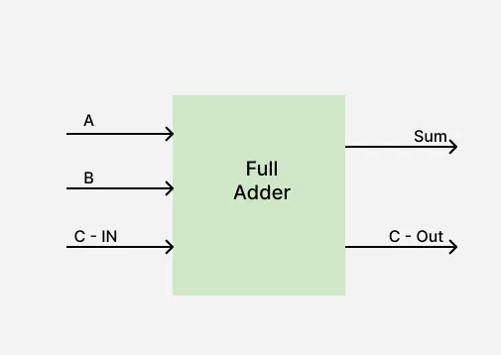
FULL ADDER – CONCEPT AND BOOLEAN EXPRESSIONS
• Inputs: A, B and Cin
• Outputs: Sum (S) and Carry Out (Cout)
• Sum: S = A ⊕ B ⊕ Cin
• Carry: Cout = AB + Cin(A ⊕ B)
• Built using two Half Adder stages and one OR gate.

Slide 8
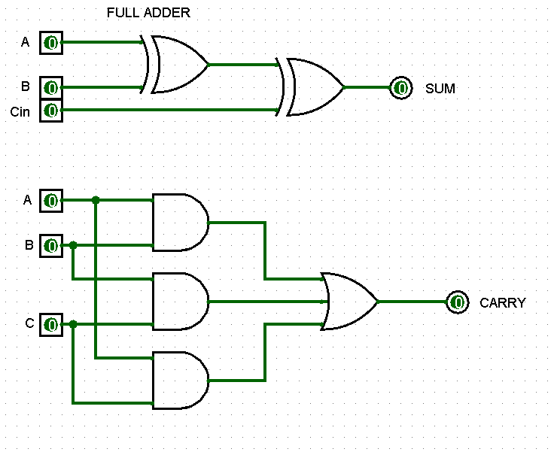
FULL ADDER – LOGISIM SIMULATION EVIDENCE

Slide 9
FULL ADDER – TRUTH TABLE
A | B | Cin | Sum | Cout
0 | 0 | 0 | 0 | 0
0 | 0 | 1 | 1 | 0
0 | 1 | 0 | 1 | 0
0 | 1 | 1 | 0 | 1
1 | 0 | 0 | 1 | 0
1 | 0 | 1 | 0 | 1
1 | 1 | 0 | 0 | 1
1 | 1 | 1 | 1 | 1

Slide 10
RESULT AND CONCLUSION
The Half Adder and Full Adder circuits were successfully designed and simulated using Logisim.
The Half Adder performs binary addition of two 1-bit inputs and produces Sum and Carry.
The Full Adder adds three 1-bit inputs, including Carry-in, and produces Sum and Carry-out.
The simulation results were verified using the respective truth tables.
Full Adders can be combined to design larger multi-bit adders used in digital systems.

Slide 11
THANK YOU
LOGISIM

